Slide 1
Riparian zones: what is the right width?
Michael J Paul, PhD

Slide 2
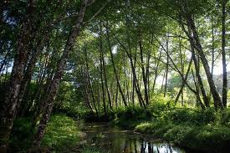
Riparian Ecosystem Goods and Services
Water cleansing – sediment, nutrients, bacteria, toxics, etc.
Channel erosion protection
Floodwater storage
Shade/Temperature moderation
Aquatic habitat – wood, rootwads, leaves, etc.
Energy – leaves/wood/fruits/terrestrial insects
Terrestrial habitat – birds/amphibians/reptiles/mammals/insects
Unique vegetation
Aesthetics
Recreation
High value land

Slide 3
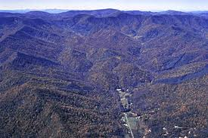
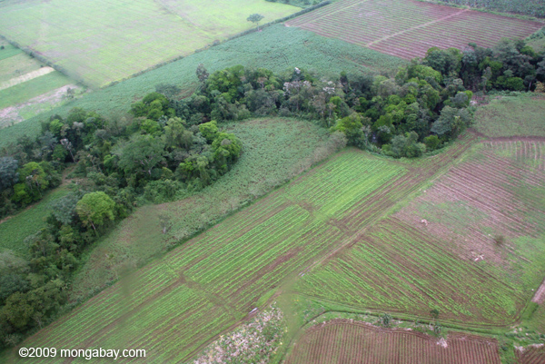
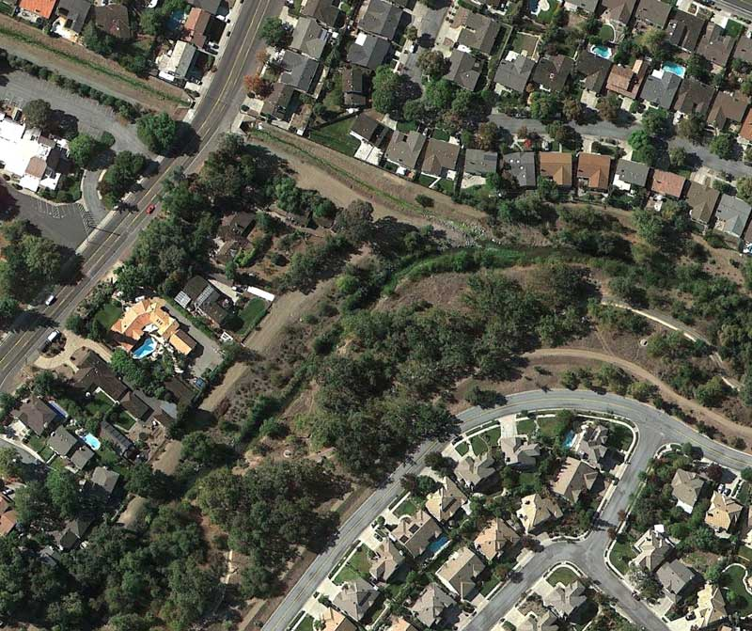
Riparian forest ecosystems
Where do they start?
Where do they end?
How wide is wide enough?
Context Dependency

Slide 4
Riparian Zone Width Recommendations
Wenger 1999
  140 papers focused on optimal width
  Included and based upon previous reviews by Correll 1997 (522 papers) and Van Deventers 1992 (3252 papers) bibliographies/reviews
  Consistent with more recent evidence as well, maybe even conservative.

Slide 5
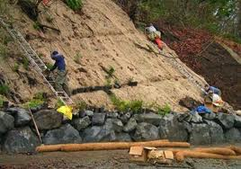
Sediment Removal
Riparian vegetation can be very efficient at sediment trapping
Length matters for duration, slope is very important
Short term removal, shallow watersheds, agriculture: 30 to 50 ft
Long term removal, steeper watershed, logging: 100 ft

Slide 6
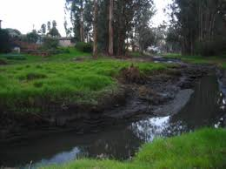
Channel Erosion
Riparian vegetation stabilizes banks
Banks can be a substantial source of sediment, especially in urbanizing areas; with historic sedimentation
No real width recommendations

Slide 7

Nutrient Removal
Riparian soils trap chemicals
But there is a lot going on down there
Nitrogen has an “out”, phosphorus does not (not ultimately)
But Nitrogen removal requires carbon and wet soils
Sediment control widths likely as good as possible for Phosphrus
For Nitrogen, 50ft minima, 100ft better

Slide 8
Fecal Bacteria/Pesticides/Metals
Many urban sources of fecal material – pets especially
Riparian forests can trap fecal bacteria – wider = more; up to 197 ft
For pesticides, 50 ft or more typically required to remove majority of pesticides
Metal removal does occur, depends on soil properties

Slide 9
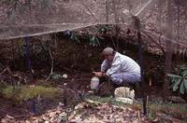
Aquatic Habitat: Wood/Leaves
Wood and Leaves
  Fuel stream food webs
  Provide habitat for in-stream organisms
  Are “critical infrastructure” for stream morphology
Width needed = 1 to 3 stream heights

Slide 10
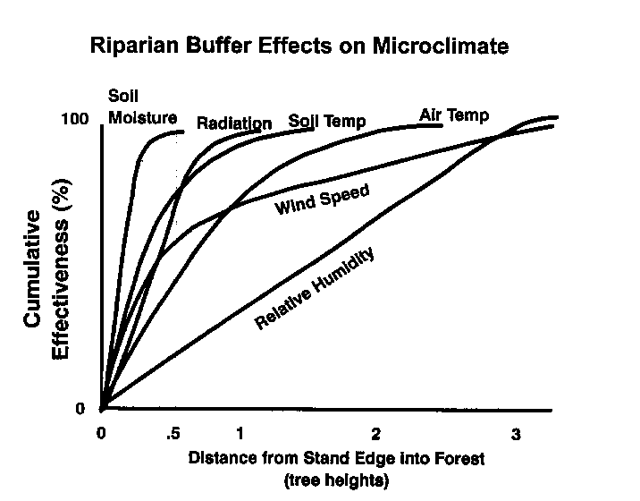
Aquatic Habitat: Light/Temperature
Riparian forests also moderate temperature and light
Affect stream microclimate and water temperature – critical environmental attribute
Recommended widths: 50 – 100ft

Slide 11
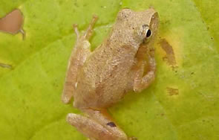
Terrestrial Habitat
Spring Peeper
Riparian zones are “ecotones” – transitional ecosystems
High diversity, high productivity = ecological hot spots
Where upland forest is altered, take on an even greater importance
Birds – min 50ft; 300ft to optimize densities and abundance
Reptiles/amphibians – Many with 300-900ft requirements
Mammals, vegetation, etc.
Width recommendation: 300 ft
  In urban areas, may not be feasible, but recognize what is lost

Slide 12
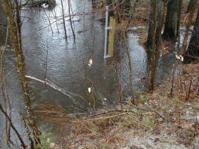
Flood Control
Floodplains also store flood waters
Riparian forests include floodplains
Vary by stream size and slope
Protect the floodplain

Slide 13
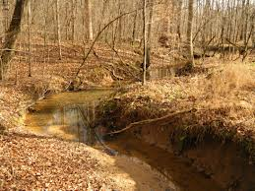
Summary
Sediment: 30 to 100+ ft (long-term)
Nutrients: 50 to 100+ ft
Other contaminants: 50 to 200+ ft
Aquatic Habitat: 50 to 200+ ft
Shade and Temperature: 50 to 200+ ft
Terrestrial habitat: 300 to 900 ft
Flood control: floodplain width (wider in larger streams)

Slide 14
Guidelines
Extent: perennial and intermittent streams; ephemeral to the extent possible.
  Why small streams matter?
Vegetation: native to the extent possible, at least in first 50 ft
  Stream organic matter; terrestrial habitat
Width: Many models have been proposed
  Slope is a major factor

Slide 15
Width Options (Wenger 1999)
Option One
  100ft + 2 ft/1% slope to 25%
  Extend to floodplain
  Include wetlands
  Impervious area not included
  All perennial and intermittent
Option 2
  50ft + 2ft/1% slope to 25%
  Not necessarily whole floodplain, but restricted
  activities
  The rest is same as above
Option 3
  100ft fixed
  Rest is same as above
Largest Risks
Terrestrial species
Some aquatic habitat
Long-term contaminant retention
Terrestrial species
Aquatic habitat on shallow streams
Short and long-term contaminant uptake
Especially steep slopes
Terrestrial species
Some aquatic habitat
Long-term contaminant retention

Slide 16
Thank you
“Science can only ascertain what is, but not what should be, and outside of its domain value judgments of all kinds remain necessary.”
-Albert Einstein

